Slide 1
FUZZY LOGIC

Slide 2
Index
Brief History
What is fuzzy logic?
Fuzzy Vs Crisp Set
Membership Functions
Fuzzy Logic Vs Probability
Why use Fuzzy Logic?
Fuzzy Linguistic Variables
Operations on Fuzzy Set
Fuzzy Applications
Case Study
Drawbacks
Conclusion
Bibliography

Slide 3
Brief History
Classical logic of Aristotle: Law of Bivalence “Every proposition is either True or False(no middle)”
Jan Lukasiewicz proposed three-valued logic : True, False and Possible
Finally Lofti Zadeh published his paper on fuzzy logic-a part of set theory that operated over the range [0.0-1.0]

Slide 4
What is Fuzzy Logic?
Fuzzy logic is a superset of Boolean (conventional) logic that handles the concept of partial truth, which is truth values between "completely true" and "completely false”.
Fuzzy logic is multivalued. It deals with degrees of membership and degrees of truth.
Fuzzy logic uses the continuum of logical values between 0 (completely false) and 1 (completely true).
Boolean
(crisp)
Fuzzy

Slide 5
For example, let a 100 ml glass contain 30 ml of water. Then we may consider two concepts: Empty and Full.
In boolean logic there are two options for answer i.e. either the glass is half full or glass is half empty.
100 ml
30 ml
In fuzzy concept one might define the glass as being 0.7 empty and 0.3 full.

Slide 6
Crisp Set and Fuzzy Set
Classical set theory enumerates all element using A={a₁,a₂,a₃,a₄…,a_{n}}
Set A can be represented by Characteristic function
μ _{a}(x)={ 1 if element x belongs to the set A
0 otherwise
}
Example: Consider space X consisting of natural number<=12
Prime={x contained in X | x is prime number={2,3,5,7,11}
In fuzzy set theory elements have varying degrees of membership
A fuzzy set can be represented by:
A={{ x, A(x) }}
where, A(x) is the membership grade of a element x in fuzzy set
SMALL={{1,1},{2,1},{3,0.9},{4,0.6},{5,0.4},{6,0.3},{7,0.2},{8,0.1},{9,0},{10,0},{11,0},{12,0}}

Slide 7
Fuzzy Vs. Crisp Set
A
A’
c
a
a
b
b
Crisp set
Fuzzy set
a: member of crisp set A
b: not a member of set A
a: full member of fuzzy set A’
b: not a member of set A’
c:partial member of set A’

Slide 8
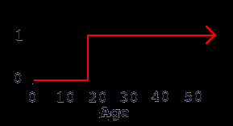
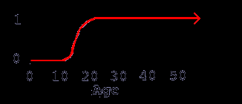
Fuzzy Vs. Crisp Set
Crisp set
Fuzzy set
Name | Age | Degree of membership
Sally | 5 | 0
Jenny | 18 | 0
Christen | 25 | 1
Name | Age | Degree of membership
Sally | 5 | 0
Jenny | 18 | 0.75
Christen | 25 | 1

Slide 9
Features of a membership function
A membership function is a mathematical function which defines the degree of an element's membership in a fuzzy set.
μ (x)
core
Core: region characterized by full membership in set A’ i.e. μ (x)=1.
Support: region characterized by nonzero membership in set A’ i.e. μ(x) >0.
Boundary: region characterized by partial membership in set A’ i.e. 0< μ (x) <1
1
0
x
boundary
support

Slide 10
Membership Functions
adult(x)= { 0, if age(x) < 16years
(age(x)-16years)/4, if 16years < = age(x)< = 20years,
1, if age(x) > 20years
}

Slide 11
Fuzzy Logic Vs Probability
Both operate over the same numeric range and at first glance both have similar values:0.0 representing false(or non-membership) and 1.0 representing true.
In terms of probability, the natural language statement would be ”there is an 80% chance that Jane is old.”
While the fuzzy terminology corresponds to “Jane’s degree of membership within the set of old people is 0.80.’
Fuzzy logic uses truth degrees as a mathematical model of the vagueness phenomenon while probability is a mathematical model of ignorance.

Slide 12
Why use Fuzzy Logic?
Fuzzy logic is flexible.
Fuzzy logic is conceptually easy to understand.
Fuzzy logic is tolerant of imprecise data.
Fuzzy logic is based on natural language.

Slide 13
Fuzzy Linguistic Variables
Fuzzy Linguistic Variables are used to represent qualities spanning a particular spectrum
Temp: {Freezing, Cool, Warm, Hot}

Slide 14
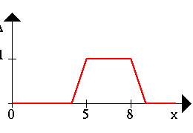
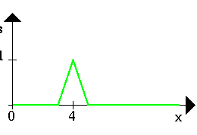
Operations on Fuzzy Set
Consider:
A= {1/2 + .5/3 + .3/4 + .2/5}
B= {.5/2 + .7/3 + .2/4 + .4/5}
μA
μB
A
B
>Fuzzy set (A)
>Fuzzy set (B)
>Resulting operation of fuzzy sets

Slide 15
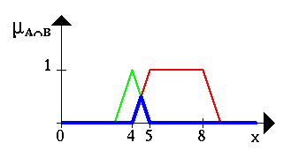
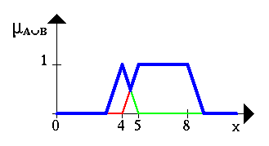
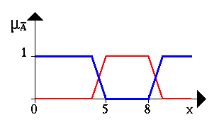
INTERSECTION
(A ^ B)
UNION
(A v B)
COMPLEMENT
(¬A)
μA U
μA ∩ B
μA ‘
μA∩ B = min (μA(x), μB(x))
{.5/2 + .5/3 + .2/4 + .2/5}
μA’ = 1-μA(x)
{1/1 + 0/2 + .5/3 + .7/4 + .8/5}
μAUB = max (μA(x), μB(x))
{1/2 + .7/3 + .3/4 + .4/5}

Slide 16
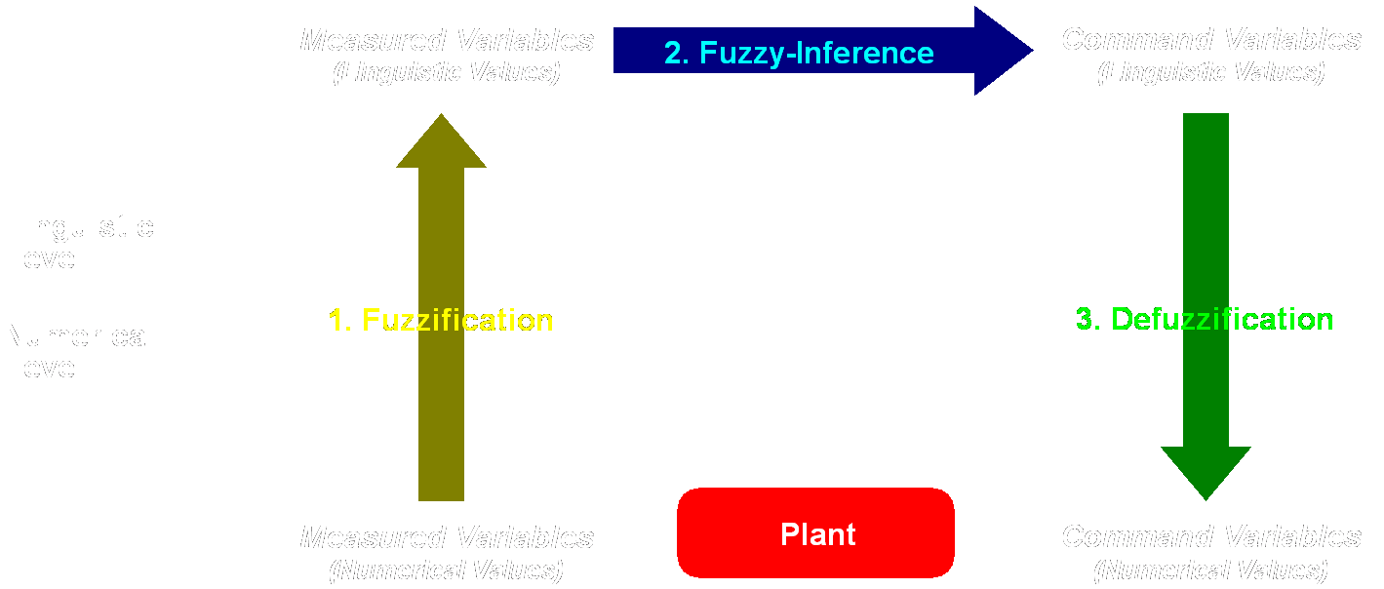
Example Speed Calculation
How fast will I go if it is
65 F°
25 % Cloud Cover ?

Slide 17
Input:
Temp: {Freezing, Cool, Warm, Hot}
Cover: {Sunny, Partly cloudy, Overcast}
Output:
Speed: {Slow, Fast}

Slide 18
Rules
If it's Sunny and Warm, drive Fast
Sunny(Cover)∧Warm(Temp)⇒ Fast(Speed)
If it's Cloudy and Cool, drive Slow
Cloudy(Cover)∧Cool(Temp)⇒ Slow(Speed)
Driving Speed is the combination of output of these rules...

Slide 19
Fuzzification: Calculate Input Membership Levels
65 F° ⇒ Cool = 0.4, Warm= 0.7
25% Cover ⇒Sunny = 0.8, Cloudy = 0.2

Slide 20
Calculating:
If it's Sunny and Warm, drive Fast
Sunny(Cover)∧Warm(Temp)⇒Fast(Speed)
0.8 ∧ 0.7 = 0.7
⇒ Fast = 0.7
If it's Cloudy and Cool, drive Slow
Cloudy(Cover)∧Cool(Temp)⇒Slow(Speed)
0.2 ∧ 0.4 = 0.2
⇒ Slow = 0.2

Slide 21
Defuzzification: Constructing the Output
Speed is 20% Slow and 70% Fast
Find centroids: Location where membership is 100%
Speed = weighted mean
= (2*25+7*75)/(9)
= 63.8 mph

Slide 22
Fuzzy Applications
Automobile and other vehicle subsystems : used to control
the speed of vehicles, in Anti Braking System.
Temperature controllers : Air conditioners, Refrigerators
Cameras : for auto-focus
Home appliances: Rice cookers , Dishwashers , Washing
machines and others

Slide 23
Drawbacks
Fuzzy logic is not always accurate. The results are perceived as
a guess, so it may not be as widely trusted .
Requires tuning of membership functions which is difficult to
estimate.
Fuzzy Logic control may not scale well to large or complex
problems
Fuzzy logic can be easily confused with probability theory, and
the terms used interchangeably. While they are similar concepts,
they do not say the same things.

Slide 24
Conclusion
Fuzzy Logic provides way to calculate with imprecision and
vagueness.
Fuzzy Logic can be used to represent some kinds of human
expertise .
The control stability, reliability, efficiency, and durability of fuzzy
logic makes it popular.
The speed and complexity of application production would not be
possible without systems like fuzzy logic.

Slide 25
Composition and inference
Fuzzy if-then rules can be aggregated into a
Single membership function= fuzzy set of input-output-pairs= fuzzy relation
Application of a fuzzy input to a fuzzy relation is the basis of decision-making in fuzzy knowledge-based systems
Decision making using fuzzy logic is known as fuzzy inference
The compositional rule of inference (CRI) is used for this
purpose
Composition plays a crucial role in fuzzy inference and fuzzy knowledge-based systems

Slide 26
Compositional rule of inference
In knowledge-based systems, knowledge is
often expressed as rules of the form:
”IF condition Y1 is y1 AND IF condition Y2 is y2
THEN state C is c”
Example: If the temperature is high and the level
of vibrations is high then the bearing is faulty
• In fuzzy knowledge-based systems, rules of this
type are linguistic statements of expert knowledge in which y1, y2 and c are fuzzy

Slide 27
Steps in fuzzy logic (2)
System use
1. Fuzzify the measured variables
2. Match the measurements with rule base
using CRI
3. Defuzzify the obtained inference
Fuzzy Inference Systems
– Mamdani Type
– Sugeno Type

Slide 28
Sugeno FIS
Sugeno FIS is similar to the Mamdani method in many respects.
The first two parts of the fuzzy inference process, fuzzifying the inputs and applying the fuzzy operator, are exactly the same.
The main difference between Mamdani and Sugeno is that the Sugeno output membership functions are either linear or constant.
A typical rule in a Sugeno fuzzy model has the form:
If Input 1 = x and Input 2 = y, then Output is z = ax + by + c

Slide 29
FIS: Sugeno vs. Mamdani
Advantages of the Sugeno Method
It is computationally efficient.
It can be used to model any inference system in which the output membership functions are either linear or constant.
It works well with linear techniques (e.g., PID control).
It works well with optimization and adaptive techniques.
It has guaranteed continuity of the output surface.
It is well suited to mathematical analysis.

Slide 30
Fuzzy Hedges
• Hedges are special terms aimed to modify other linguistic terms
• Can be used to modify elements such as:
– Fuzzy predicates
– Fuzzy truth values
– Fuzzy probabilities
• Examples: – “Very”, “more or less”, “fairly”, “extremely”, etc
Fuzzy Hedges – Examples
• Modification of a fuzzy predicate – “x is very young” •Modification of a fuzzy truth value – “x is young is very true” •Modification of a fuzzy probability – “x is young is very likely”
• Modification of both a predicate and a truth value – “x is very young i

Slide 31
Neuro-fuzzy systems
Combined neural networks and fuzzy logic
systems
Problems with both linguistic and numeric
knowledge
• Neuro-fuzzy can provide a solution
Features of fuzzy logic and neural networks-based systems
The fuzzy logic system and the neural network work as
one synchronized entity
• Parallel architecture Same architecture as traditional fuzzy systems except that a layer of hidden neurons performs each of

Slide 32
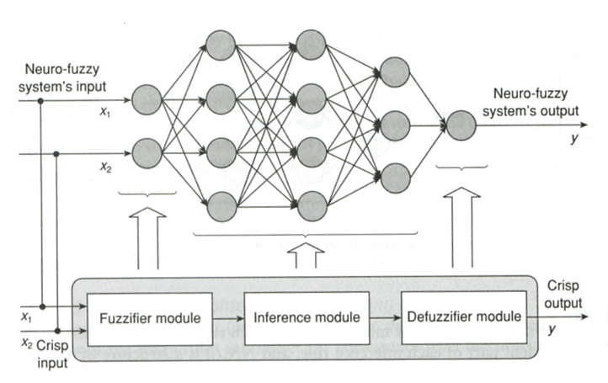
Construction of neuro-fuzzy systems

Slide 33
Construction of neuro-fuzzy systems
• Structure learning phase
– Determining the fuzzy rules structure
– Based on partitioning of the input-output
space
– Each partition represents one rule
– Overlap between boundaries in fuzzy systems
– Several partitioning methods
• Grid-type partitioning (fixed or adaptive)
• Clustering
• Scatter partitioning

Slide 34
Bibliography
BOOK :
Artificial Intelligence by Elaine Rich, Kelvin Knight and Shivashankar B Nair
Internet

